Slide 1



THE ALPHA TEST
As an environmental science student, one may be wondering why you need to study management. What three reasons will you give if a colleague from a different university asks why your department offers Principles of Management as a course?

Slide 2
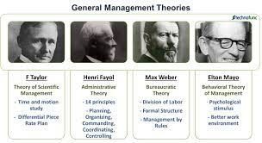
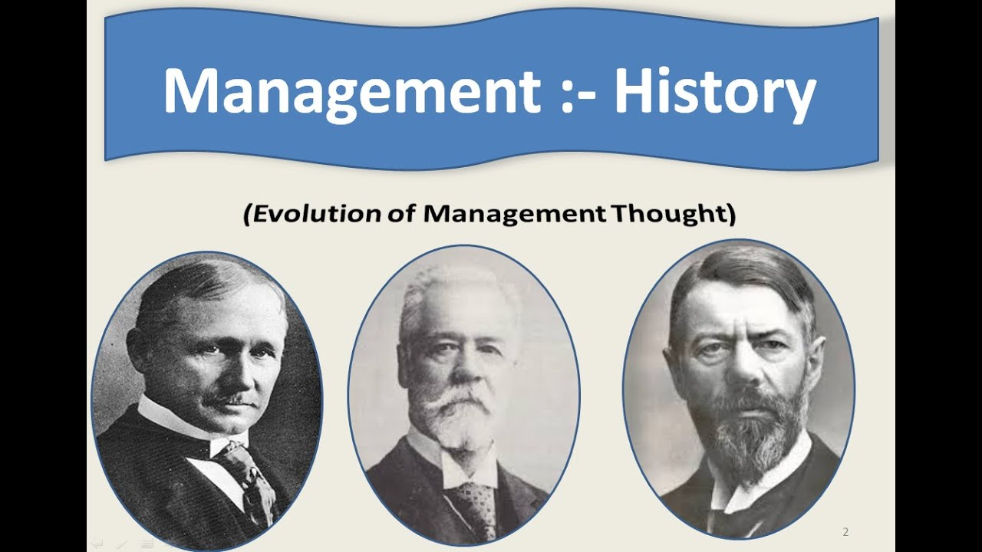

LOOKING BACK: THE HISTORY OF MANAGEMENT
UNIT 1b

Slide 3
LEARNING OUTCOMES
Describe some early management examples.
Explain the various theories in the classical approach.
Discuss the development and uses of the behavioral approach.
Describe the quantitative approach.
Explain the various theories in the contemporary approach.

Slide 4
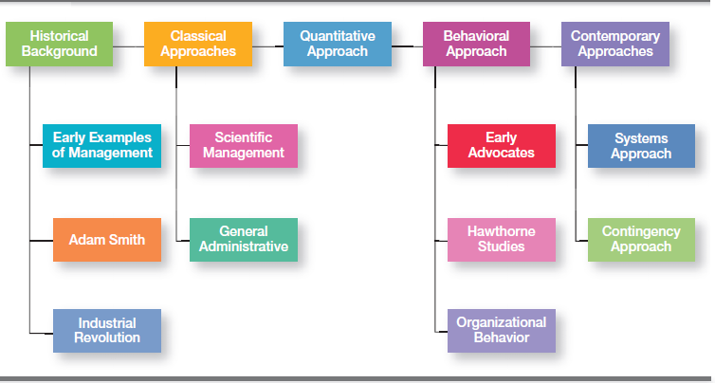
EXHIBIT MH-1 MAJOR APPROACHES TO MANAGEMENT

Slide 5


EARLY MANAGEMENT
Ancient Management - Egypt (pyramids) and China (Great Wall): The Egyptian pyramids and the Great Wall of China are proof that projects of tremendous scope, employing tens of thousands of people, were completed in ancient times

Slide 6
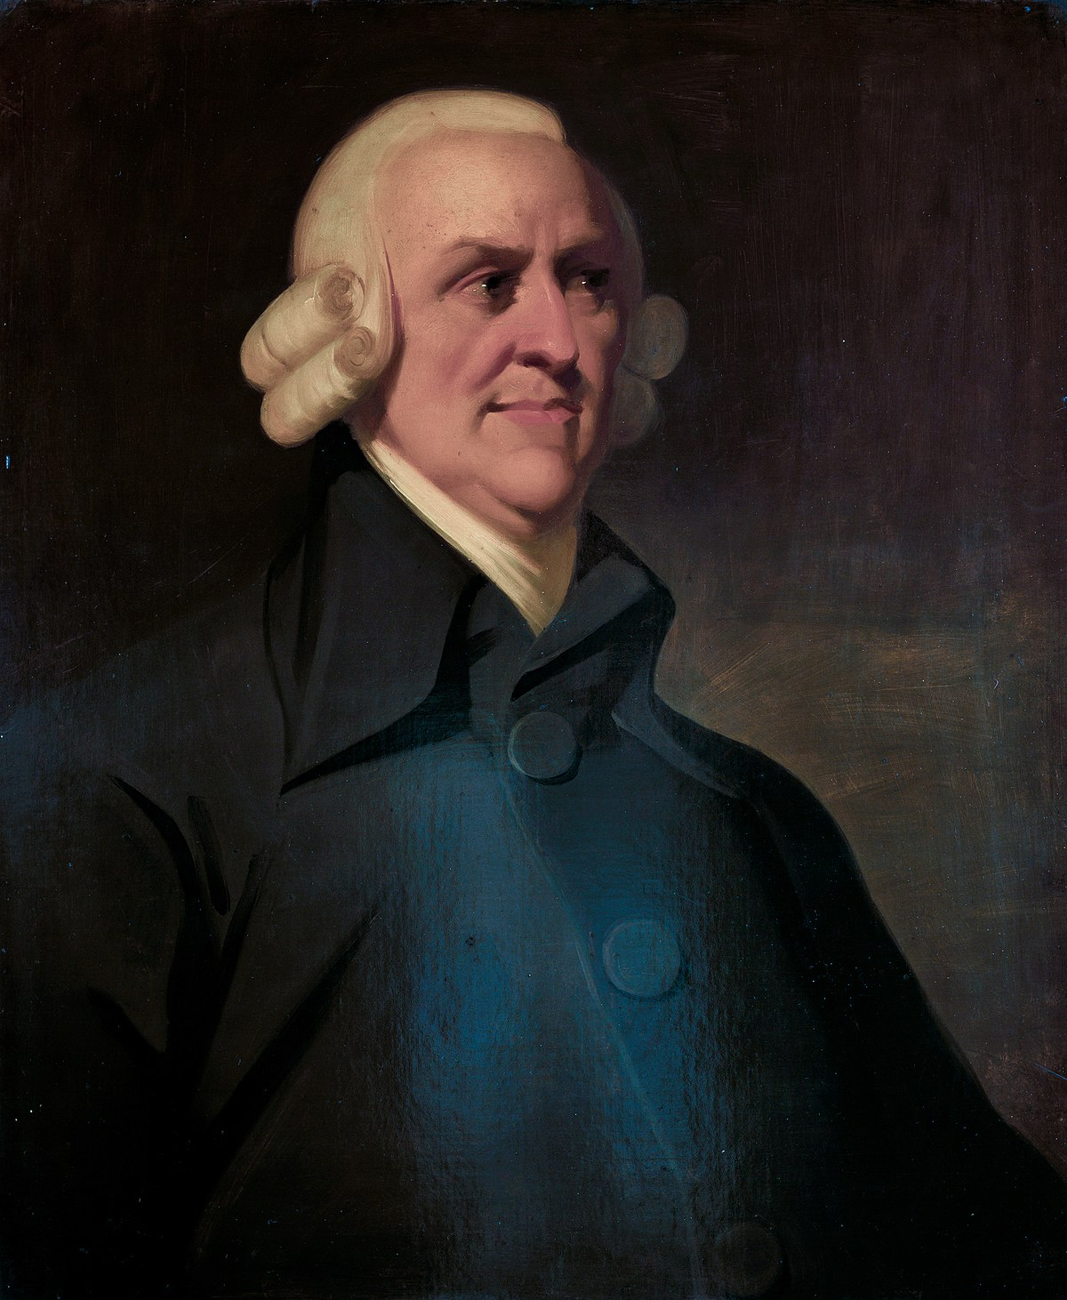
EARLY MANAGEMENT
In 1776, Adam Smith published The Wealth of Nations, in which he argued the economic advantages that organizations and society would gain from the division of labor (or job specialization)—that is, breaking down jobs into narrow and repetitive tasks.
Starting in the late eighteenth century when machine power was substituted for human power, a point in history known as the industrial revolution, it became more economical to manufacture goods in factories rather than at home. These large efficient factories needed someone to forecast demand, ensure that enough material was on hand to make products, assign tasks to people, direct daily activities, and so forth.

Slide 7
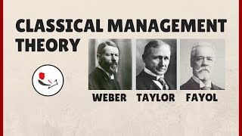
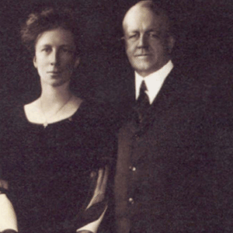
CLASSICAL APPROACH
The first studies of management, often called the classical approach, emphasized rationality and making organizations and workers as efficient as possible.
Two major theories comprise the classical approach: Scientific management and General administrative theory.
The two most important contributors to scientific management theory were Frederick W. Taylor and the husband-wife team of Frank and Lillian Gilbreth.
The two most important contributors to general administrative theory were Henri Fayol and Max Weber. Let’s take a look at each of these important figures in management history.

Slide 8
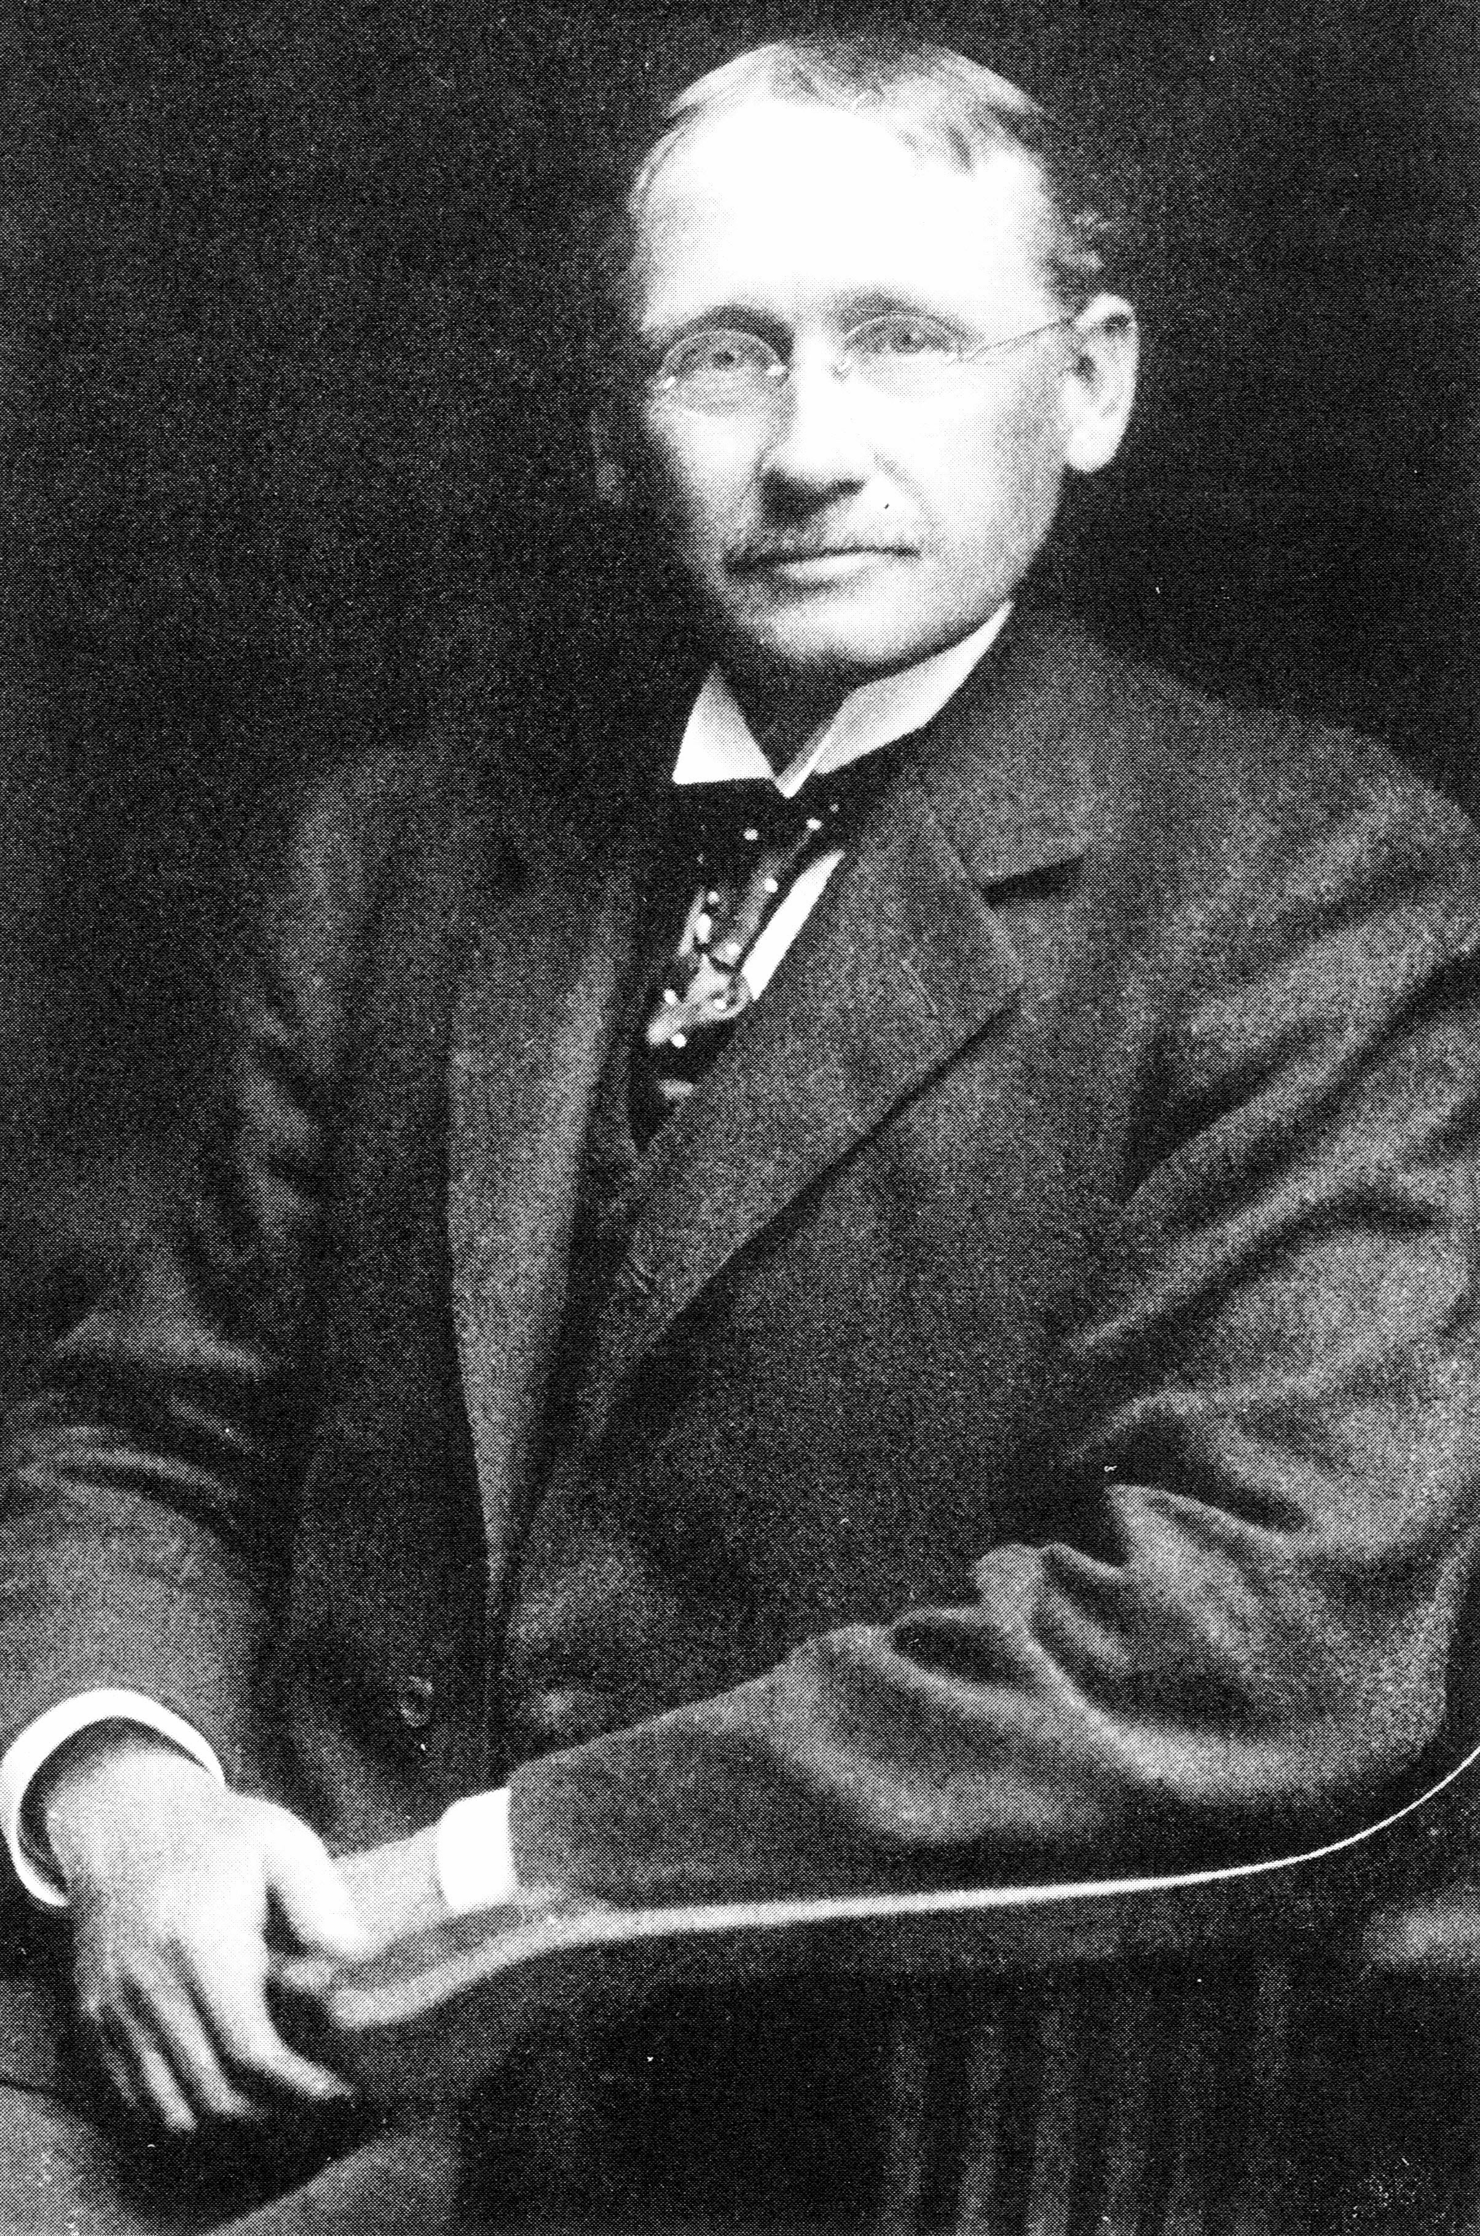
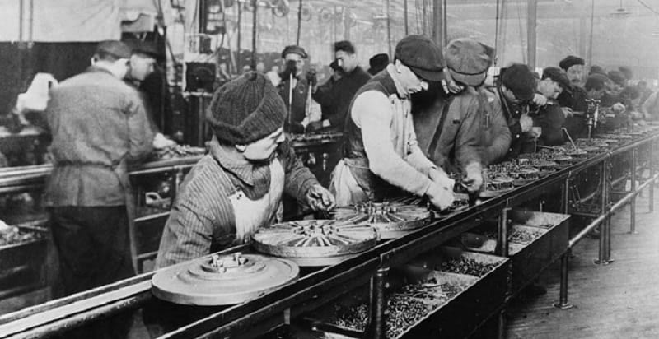
SCIENTIFIC MANAGEMENT
Fredrick Winslow Taylor
The “father” of scientific management
Scientific management - an approach that involves using the scientific method to find the “one best way” for a job to be done.

Slide 9
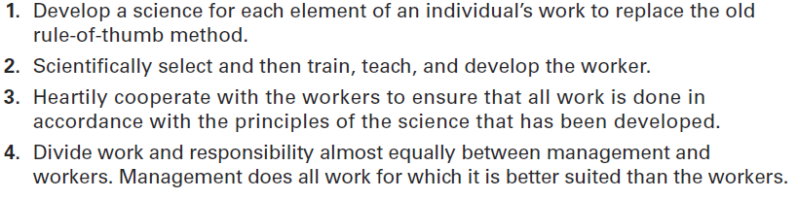
EXHIBIT MH-2 TAYLOR’S SCIENTIFIC MANAGEMENT PRINCIPLES

Slide 10
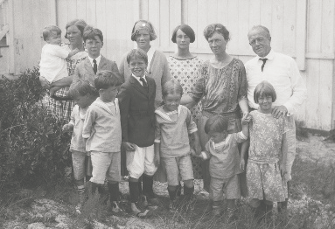
FRANK AND LILLIAN GILBRETH
Taylor’s most prominent followers were Frank and Lillian Gilbreth. Frank and his wife Lillian, a psychologist, studied work to eliminate inefficient hand-and-body motions. The Gilbreths also experimented with the design and use of the proper tools and equipment for optimizing work performance.
The Gilbreths also devised a classification scheme to label 17 basic hand motions (such as search, grasp, hold), which they called therblig (Gilbreth spelled backward with the th transposed). This scheme gave the Gilbreths a more precise way of analyzing a worker’s exact hand movements.

Slide 11
GENERAL ADMINISTRATIVE THEORY
General administrative theory - an approach to management that focuses on describing what managers do and what constitutes good management practice

Slide 12
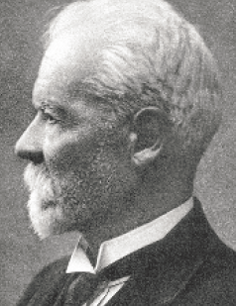
HENRI FAYOL
Henri Fayol described the practice of management as something distinct from accounting, finance, production, distribution, and other typical business functions. His belief that management was an activity common to all business endeavors, government, and even the home led him to develop 14 principles of management—fundamental rules of management that could be applied to all organizational situations and taught in schools. These principles are shown in Exhibit MH-3

Slide 13
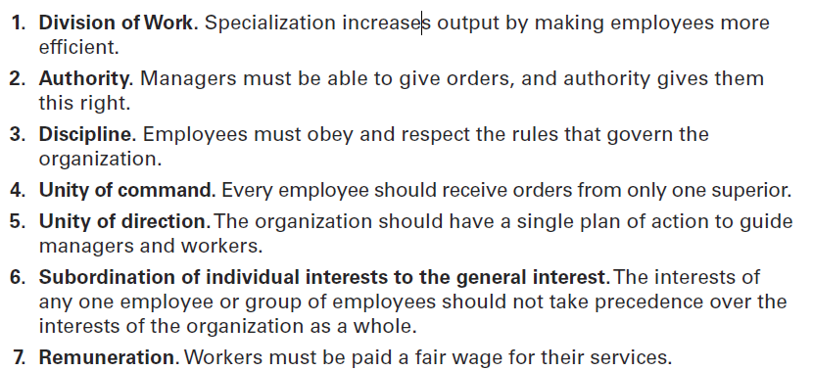
EXHIBIT MH-3 FAYOL’S 14 PRINCIPLES OF MANAGEMENT

Slide 14
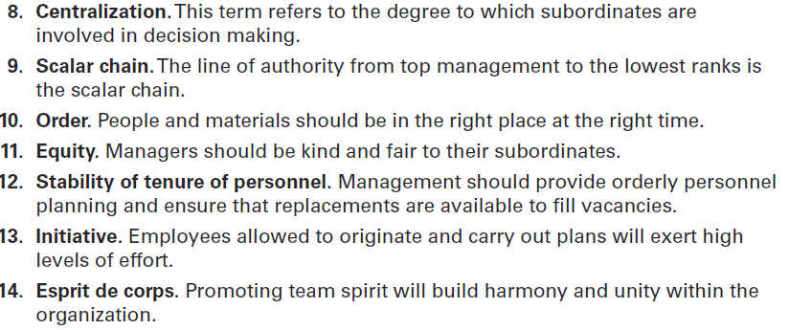
EXHIBIT MH-3 FAYOL’S 14 PRINCIPLES OF MANAGEMENT (CONT.)

Slide 15
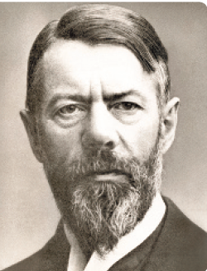
GENERAL ADMINISTRATIVE THEORY (CONT.)
Max Weber was a German sociologist who studied organizations. Writing in the early 1900s, he developed a theory of authority structures and relations based on an ideal type of organization he called a bureaucracy—a form of organization characterized by division of labor, a clearly defined hierarchy, detailed rules and regulations, and impersonal relationships. (See Exhibit MH-4.)

Slide 16
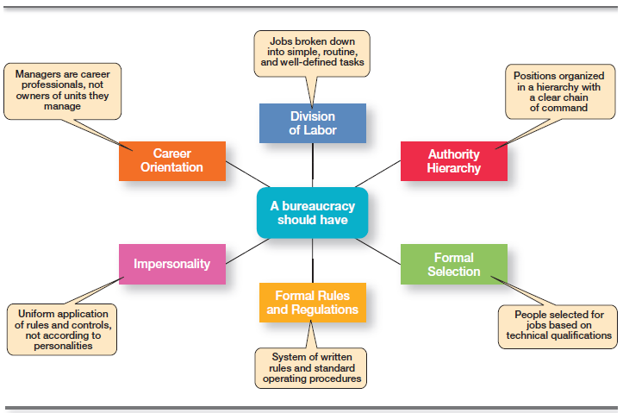
EXHIBIT MH-4 CHARACTERISTICS OF WEBER’S BUREAUCRACY

Slide 17



BEHAVIOURAL APPROACH
The field of study that researches the actions (behavior) of people at work is called organizational behavior (OB). Much of what managers do today when managing people—motivating, leading, building trust, working with a team, managing conflict, and so forth—has come out of OB research.
Although a number of individuals in the early twentieth century recognized the importance of people to an organization’s success, four stand out as early advocates of the OB approach: Robert Owen, Hugo Munsterberg, Mary Parker Follett, and Chester Barnard. Their contributions were varied and distinct, yet all believed that people were the most important asset of the organization and should be managed accordingly.

Slide 18
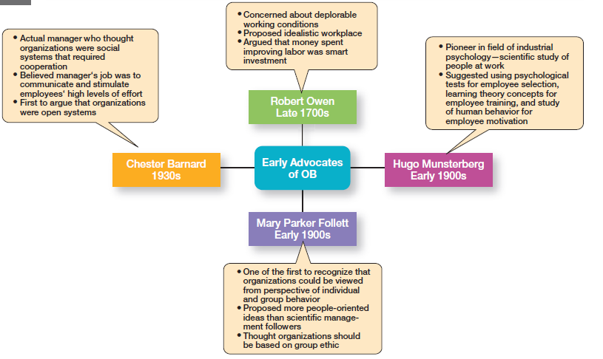
EXHIBIT MH-5 EARLY OB ADVOCATES

Slide 19
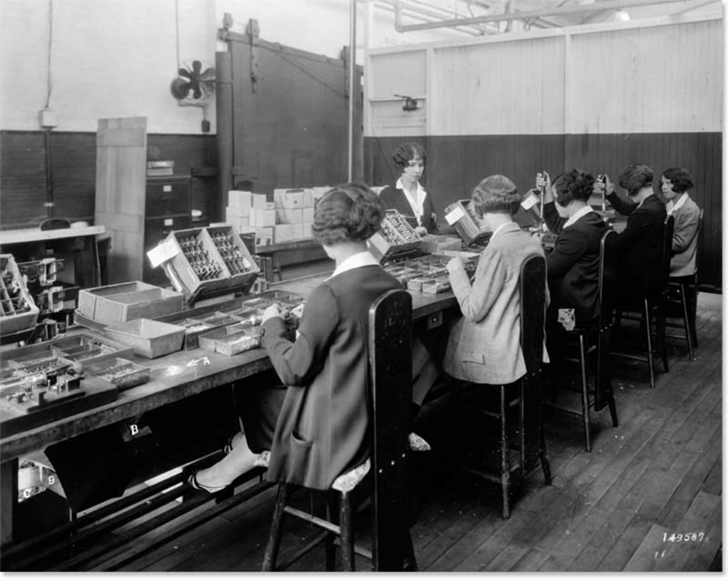
HAWTHORNE STUDIES
Scholars generally agree that the Hawthorne Studies had a game-changing impact on management beliefs about the role of people in organizations. Elton Mayo concluded Hawthorne Studies . A series of studies during the 1920s and 1930s that provided new insights into individual and group behavior. The studies concluded that people’s behavior and attitudes are closely related, that group factors significantly
affect individual behavior, that group standards establish individual worker output, and that money is less a factor in determining output than group standards, group attitudes, and security. These conclusions led to a new emphasis on the human behavior factor in the management of organizations.

Slide 20
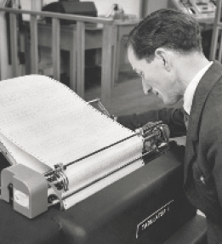
THE QUANTITATIVE APPROACH
The quantitative approach is the use of quantitative techniques to improve decision making. This approach also is known as management science.
The quantitative approach evolved from mathematical and statistical solutions developed for military problems during World War II. After the war was over, many of these techniques used for military problems were applied to businesses.

Slide 21
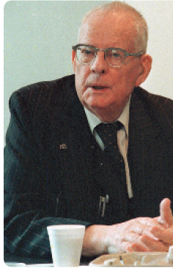
TOTAL QUALITY MANAGEMENT (TQM)
Total quality management (TQM) - a philosophy of management that is driven by continuous improvement and responsiveness to customer needs and expectations
Notes:
Another area where quantitative techniques are used frequently is in total quality management. A quality revolution swept through both the business and public sectors in the 1980s and 1990s.10 It was inspired by a small group of quality experts; the most famous was W. Edwards Deming (pictured at right) and Joseph M. Juran. The ideas and techniques they advocated in the 1950s had few supporters in the United States but were enthusiastically embraced by Japanese organizations. As Japanese manufacturers began beating U.S. competitors in quality comparisons, however, Western managers soon took a more serious look at Deming’s and Juran’s ideas, which became the basis for today’s quality management programs.
Total quality management, or TQM, is a management philosophy devoted to continual improvement and responding to customer needs and expectations. (See Exhibit MH-6.) The term customer includes anyone who interacts with the organization’s product
or services, internally or externally. It encompasses employees and suppliers as well as the people who purchase the organization’s goods or services

Slide 22
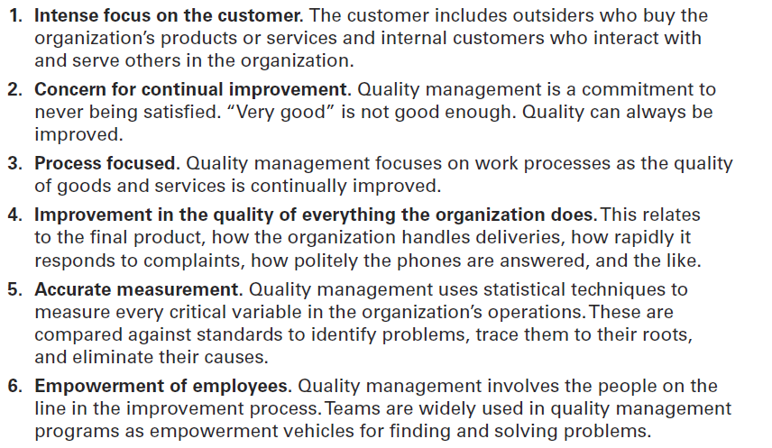
EXHIBIT MH-6 WHAT IS QUALITY MANAGEMENT?

Slide 23
CONTEMPORARY APPROACHES
System - a set of interrelated and interdependent parts arranged in a manner that produces a unified whole.
Closed system - systems that are not influenced by and do not interact with their environment
Open system - systems that interact with their environment
Notes:
Most of these earlier approaches focused on managers’ concerns inside the organization. Starting in the 1960s, management researchers began to look at what was happening in the external environment outside the boundaries of the organization. Two contemporary management perspectives— systems and contingency—are part of this approach. Systems theory is a basic theory in the physical sciences, but had never been applied to organized human efforts.
A system is a set of interrelated and interdependent parts arranged in a manner that produces a unified whole. The two basic types of systems are closed and open. Closed systems are not influenced by and do not interact with their environment. In contrast, open systems are influenced by and do interact with their environment. Today, when we describe organizations as systems, we mean open systems.

Slide 24
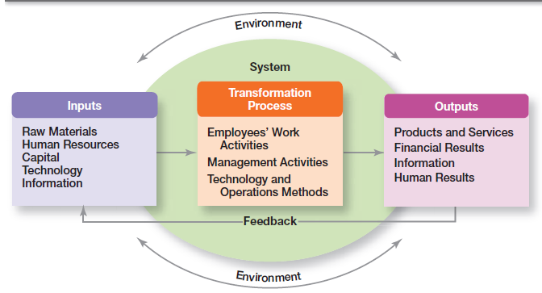
EXHIBIT MH-7 ORGANIZATION AS AN OPEN SYSTEM

Slide 25
THE CONTINGENCY APPROACH
Different and changing situations require managers to use different approaches and techniques. The contingency approach (sometimes called the situational approach) says that organizations are different, face different situations (contingencies), and require different ways of managing.

Slide 26
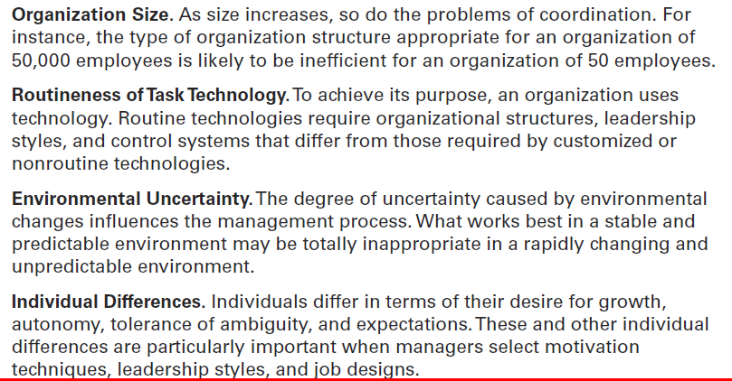
EXHIBIT MH-8 POPULAR CONTINGENCY VARIABLES

Slide 27

ANY QUESTION?

Slide 28

END OF LESSON

